Slide 1
Artificial Intelligence & Machine Learning
TEXTBOOKS/LEARNING RESOURCES:
a) Masashi Sugiyama, Introduction to Statistical Machine Learning (1st ed.), Morgan Kaufmann, 2017. ISBN 978-0128021217.
b) T. M. Mitchell, Machine Learning (1st ed.), McGraw Hill, 2017. ISBN 978-1259096952.
REFERENCE BOOKS/LEARNING RESOURCES:
a) Richard Golden, Statistical Machine Learning A Unified Framework (1st ed.), unknown, 2020.

Slide 2
SVM-Support Vector Machine
Invented by V. N. Vapnik and Alexey Ya. Chervonenkis in 1963.

Slide 3
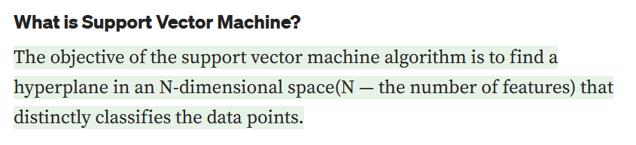
Support Vector Machine Classifier
Introduction
SVM is a powerful supervised algorithm that works best on smaller datasets but on complex ones.
SVM can be used for both regression and classification tasks, but generally, they work best in classification problems.
What is Hyperplane??

Slide 4
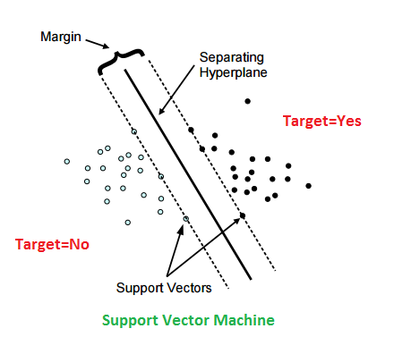
Support Vector Machine Classifier
What is Hyperplane??
To separate the two classes of data points, there are many possible separation lines that could be drawn, and these separation lines are known as Hyperplanes.
Hyperplanes are decision boundaries that help classify the data points. Data points falling on either side of the hyperplane can be attributed to different classes.
Our objective is to find a plane that has the maximum margin, i.e the maximum distance between data points of both classes. Maximizing the margin distance provides some reinforcement so that future data points can be classified with more confidence.

Slide 5
Support Vector Machine Classifier
Also, the dimension of the hyperplane depends upon the number of features.
If the number of input features is 2, then the hyperplane is just a line.
If the number of input features is 3, then the hyperplane becomes a two-dimensional plane.
It becomes difficult to imagine when the number of features exceeds 3.

Slide 6

Support Vector Machine Classifier
Key Idea:
Goal of the SVM is to find the Optimal Separating Hyperplane which maximizes the separability of the training data.
w x + b>0
w x + b=0
How to Classify ?
w x + b<0

Slide 7
Support Vector Machine Classifier
Selecting Optimal Hyperplane
w x + b=0
w x + b>0
which is best?
w x + b<0

Slide 8
Support Vector Machine Classifier
Selecting Optimal Hyperplane
w x + b>0
Hyperplane should be as far as possible from data points.
Narrow margin Hyperplane leads to misclassification.
Our aim is to maximize the margin.
w x + b=0
Misclassified to +ve Class
w x + b<0

Slide 9
Support Vector Machine Classifier
Optimal Hyperplane
w x + b=0
w x + b>0
Support Vectors bubbles
Margin
is distance between the hyperplane and the closest data points.
No –Data region
Larger margin reduce the chances of misclassification.
w x + b<0
w x + b = +K
w x + b = -K

Slide 10





Support Vector Machine Classifier
Support Vector
Support vectors are data points that are closer to the hyperplane and influence the position and orientation of the hyperplane.
Using these support vectors, we maximize the margin of the classifier.
Deleting the support vectors will change the position of the hyperplane.
These are the points that help us build our SVM.

Slide 11
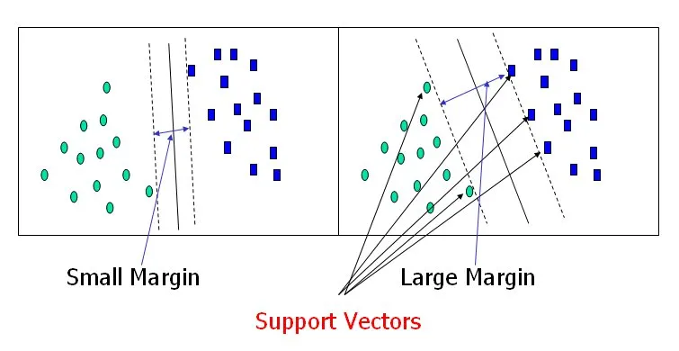
Support Vector Machine Classifier
M=Margin Width
Class = +1
wx+b=1
Class = -1
wx+b=0
wx+b=-1
Our aim is to maximize the margin.

Slide 12
Support Vector Machine Classifier
Mode of Operation
Training Mode
Testing mode
SVM Model
Classified object
Training Data
Set
Training Mode
Test Data
Set
Testing Mode

Slide 13
Support Vector Machine Classifier
Finding Weight (W) and Bias (B) for optimal hyperplane [5]:
Step1: Select the Support Vectors
4 -
3 -
2 -
1 -
0 -
-1-
-2-
-3-
-4-
2
1
2
-1
4
0
Blue= -ve Class
S1 =
S2 =
S3 =
Red= +ve Class
S1
S3
| | | | | | |
1 2 3 4 5 6 7
Step2: Apply Bias b = 1, augmented vectors are
S2
S1 =
2
1
1
S2 =
2
-1
1
S3 =
4
0
1
Support Vectors

Slide 14
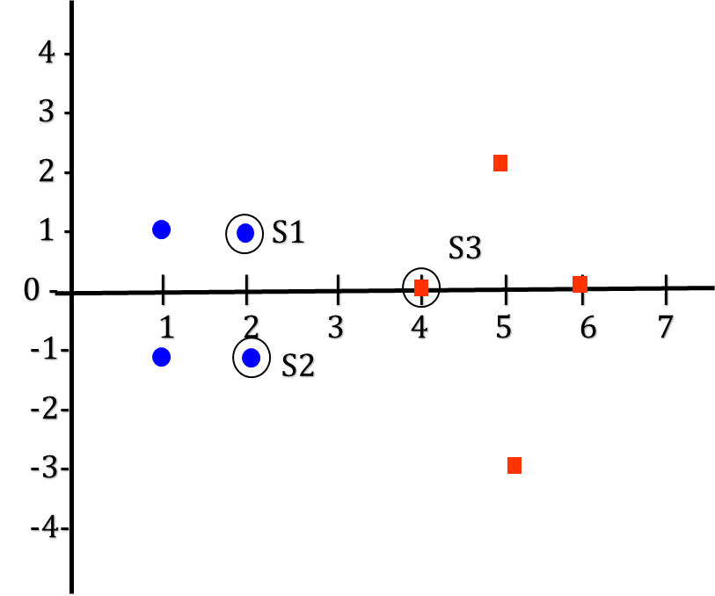
Support Vector Machine Classifier
Lagrange Multiplier
Step3: Compute three parameters 𝛼1, 𝛼2 and 𝛼3
𝛼1𝑆1 .𝑆1 +𝛼2𝑆2 .𝑆1 +𝛼3𝑆3 .𝑆1 = −1 (−𝑣𝑒 𝑐𝑙𝑎𝑠𝑠)
𝛼1𝑆1 .𝑆2 +𝛼2𝑆2 .𝑆2 +𝛼3𝑆3 .𝑆2 = −1 (−𝑣𝑒 𝑐𝑙𝑎𝑠𝑠)
𝛼1𝑆1 .𝑆3 +𝛼2𝑆2 .𝑆3 +𝛼3𝑆3 .𝑆3 = +1 (+𝑣𝑒 𝑐𝑙𝑎𝑠𝑠)
Substitute the value of S1 , S2 and S3
2
1
1
2
1
1
2
-1
1
2
1
1
4
0
1
2
1
1
𝛼1 + 𝛼2 + 𝛼3 = -1 ⟹ 6𝛼1+4𝛼2+9𝛼3 = −1
2
1
1
2
-1
1
2
-1
1
2
-1
1
4
0
1
2
-1
1
𝛼1 + 𝛼2 + 𝛼3 = -1 ⟹ 4𝛼1+6𝛼2+9𝛼3 = −1
2
1
1
4
0
1
2
-1
1
4
0
1
4
0
1
4
0
1
𝛼1 + 𝛼2 + 𝛼3 = 1 ⟹ 9𝛼1+9𝛼2+17𝛼3 = +1

Slide 15
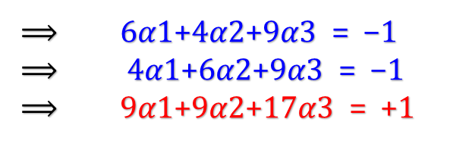

Support Vector Machine Classifier
Solving above three equations
𝛼1 = 𝛼2 = -3.25 and 𝛼3 = 3.5
Step4: Now the hyperplane is give by
4 -
3 -
2 -
1 -
0 -
-1-
-2-
-3-
-4-
Blue= -ve Class
Red= +ve Class
2
1
1
2
-1
1
4
0
1
W = -3.25 - 3.25 + 3.5
| | | | | | |
1 2 3 4 5 6 7
1
0
-3
Weight (w)
W =
Bias (b)

Slide 16
Non Linear - SVM Classifier
SVM - Non Linear Separable Data [6]

Slide 17
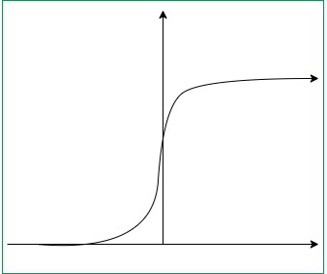
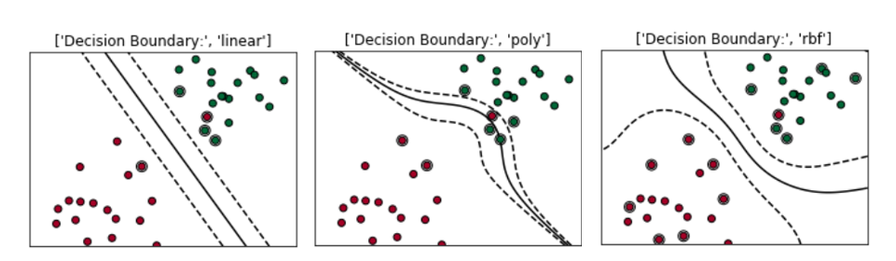
Non Linear - SVM Classifier
Kernel Trick Function [6] [Vapnik, 1992]
1. Linear:
2. Polynomial of power:
3. Gaussian (radial-basis function):
4. Sigmoid:

Slide 18
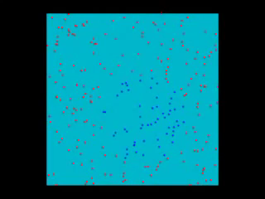
SVM with Polynomial Kernel Function [Accessed on 29 Nov 2017 https://www.youtube.com/watch?v=3liCbRZPrZA]

Slide 19
Non Linear - SVM Classifier
SVM - Non Linear Separable Data [6]
Example
4 -
3 -
2 -
1 -
-
-1-
-2-
-3-
-4-
-1
1
1
1
-1
-1
1
1
Blue Class: P = Q= R= S=
2
0
0
2
-2
0
0
-2
A
D B
C
Red Class: A = B= C= D=
P Q
R S
| | | | | | |
-3 -2 -1 1 2 3

Slide 20
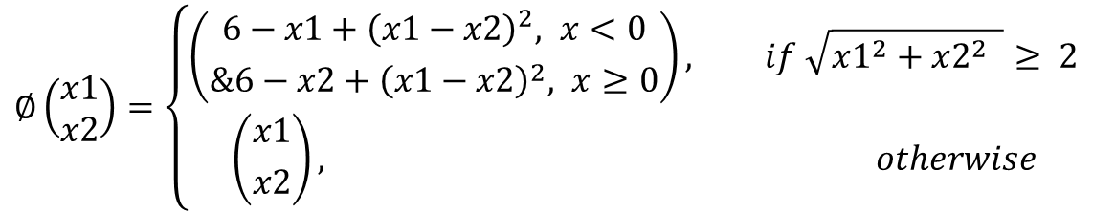
Non Linear - SVM Classifier
Step1: Transform the points to higher space by using some mapping function
$$∅\left(\begin{aligned}x1 \\ x2\end{aligned}\right)=\left\{\begin{aligned}\left({6−x1+{\left(x1−x2\right)}^{2}, x<0 \atop \&6−x2+{\left(x1−x2\right)}^{2}, x≥0}\right), if \sqrt{x1^{2}+x2^{2} }≥ 2 \\ \left({x1 \atop x2}\right), otherwise\end{aligned}\right.$$
Old Value New Value
Old Value New Value
2
0
8
10
0
2
10
8
Red Class: A = = B= =
C= = D= =
-2
0
12
10
0
-2
10
12
For blue, it remains unchanged since $\sqrt{x1^{2}+x2^{2} }$ ≵ 2

Slide 21
Non Linear - SVM Classifier
8
10
10
8
12
10
10
12
Red Class: A = B= C= D=
SVM - Non Linear Separable Data [6]
Example
-1
1
1
1
-1
-1
1
1
14-
12-
12-
10-
9 -
8 -
7 -
6 -
5 -
4-
3-
2-
1-
--
-1-
Blue Class: P = Q= R= S=
D
A C
B
P Q
R S
| | | | | | | | | | | | | | | | | |
-1 1 2 3 4 5 6 7 8 9 10 11 12 13 14 15 16

Slide 22
Working of kernel
Mathematical definition: K(x, y) = <f(x), f(y)>. Here K is the kernel function, x, y are n dimensional inputs. f is a map from n-dimension to m-dimension space. < x,y> denotes the dot product. usually m is much larger than n.
Intuition: Normally calculating <f(x), f(y)> requires us to calculate f(x), f(y) first, and then do the dot product. These two computation steps can be quite expensive as they involve manipulations in m dimensional space, where m can be a large number. But after all the trouble of going to the high dimensional space, the result of the dot product is really a scalar: we come back to one-dimensional space again!
Simple Example: x = (x1, x2, x3); y = (y1, y2, y3). Then for the function f(x) = (x1x1, x1x2, x1x3, x2x1, x2x2, x2x3, x3x1, x3x2, x3x3), the kernel is K(x, y ) = (<x, y>)².
Let’s plug in some numbers to make this more intuitive: suppose x = (1, 2, 3); y = (4, 5, 6). Then:
f(x) = (1, 2, 3, 2, 4, 6, 3, 6, 9)
f(y) = (16, 20, 24, 20, 25, 30, 24, 30, 36)
<f(x), f(y)> = 16 + 40 + 72 + 40 + 100+ 180 + 72 + 180 + 324 = 1024
A lot of algebra, mainly because f is a mapping from 3-dimensional to 9 dimensional space.
Now let us use the kernel instead:
K(x, y) = (4 + 10 + 18 ) ^2 = 32² = 1024
Same result, but this calculation is so much easier.

Slide 23
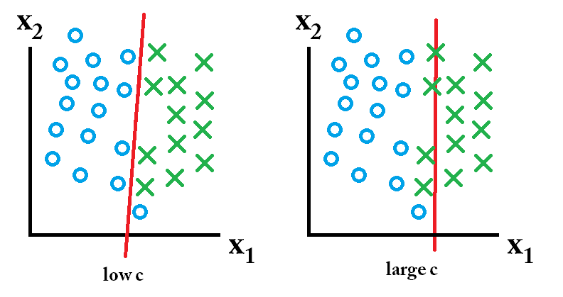
Parameters in SVM kernel (C)
C- It is a hypermeter in SVM to control error. What does that mean to control error or margin?
If we have low C means low error and if we have large C means large error.
In low C we have only one error but in case of large C, we have four errors.

Slide 24
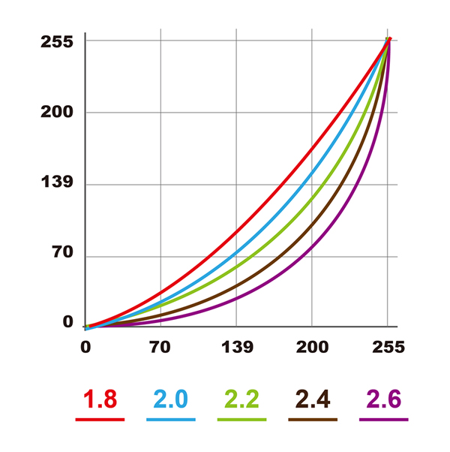
Parameters in SVM kernel(Gamma)
Gamma is used when we use the Gaussian RBF kernel.
if you use linear or polynomial kernel then you do not need gamma only you need C hypermeter. Somewhere it is also used as sigma.
Sigma and gamma are related.
Gamma high means more curvature.
Gamma low means less curvature.

Slide 25

When should we tune high or low gamma?
It is totally dependent upon data.
C is a hypermeter which is set before the training model and used to control error and
Gamma is also a hypermeter which is set before the training model and used to give curvature weight of the decision boundary.
For choosing C we generally choose the value like 0.001, 0.01, 0.1, 1, 10, 100
and same for Gamma 0.001, 0.01, 0.1, 1, 10, 100

Slide 26
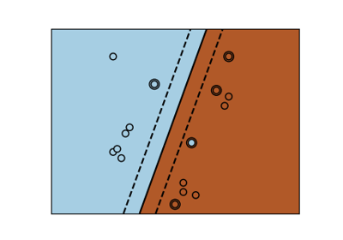
Linear kernel
In linear kernel, the kernel function takes the form of a linear function as follows-
linear kernel : K(xi , xj ) = xiT. xj
Linear kernel is used when the data is linearly separable.
It means that data can be separated using a single line. It is one of the most common kernels to be used. It is mostly used when there are large number of features in a dataset.
Linear kernel is often used for text classification purposes.
Training with a linear kernel is usually faster, because we only need to optimize the C regularization parameter.
When training with other kernels, we also need to optimize the γ parameter. So, performing a grid search will usually take more time.

Slide 27
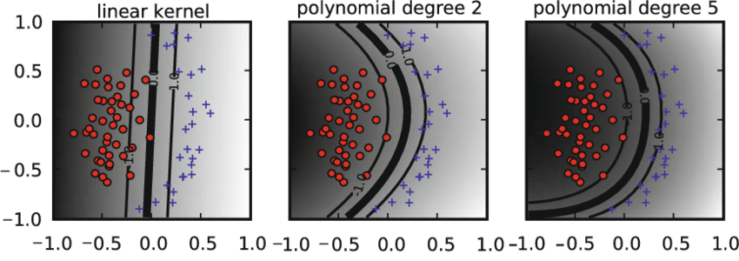
Polynomial Kernel
Polynomial kernel represents the similarity of vectors (training samples) in a feature space over polynomials of the original variables.
The polynomial kernel looks not only at the given features of input samples to determine their similarity, but also combinations of the input samples.
For degree-d polynomials, the polynomial kernel is defined as follows –
Polynomial kernel :
Polynomial kernel is very popular in Natural Language Processing.
The most common degree is d = 2 (quadratic), since larger degrees tend to overfit on NLP problems. It can be visualized with the following diagram.

Slide 28
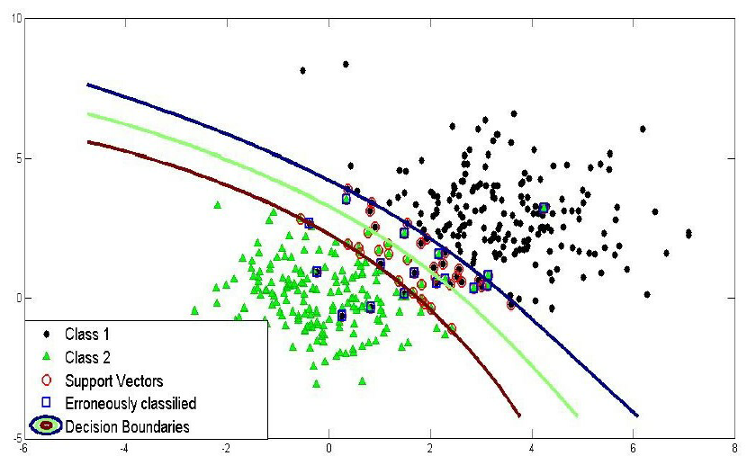
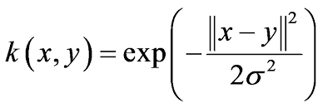
Radial basic Kernel
Radial basis function kernel is a general-purpose kernel.
It is used when we have no prior knowledge about the data.
The RBF kernel on two samples x and y is defined by the following equation –

Slide 29
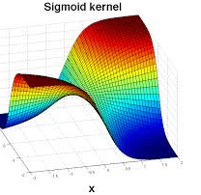
Sigmoid kernel
Sigmoid kernel has its origin in neural networks.
We can use it as the proxy for neural networks. Sigmoid kernel is given by the following equation –
sigmoid kernel : k (x, y) = tanh(αxTy + c)
Sigmoid kernel can be visualized with the following diagram-

Slide 30
Advantages:
SVM works relatively well when there is a clear margin of separation between classes.
SVM is more effective in high dimensional spaces.
SVM is effective in cases where the number of dimensions is greater than the number of samples.
SVM is relatively memory efficient

Slide 31
Disadvantages:
SVM algorithm is not suitable for large data sets.
SVM does not perform very well when the data set has more noise i.e. target classes are overlapping.
In cases where the number of features for each data point exceeds the number of training data samples, the SVM will underperform.
As the support vector classifier works by putting data points, above and below the classifying hyperplane there is no probabilistic explanation for the classification.

Slide 32
Applications of SVM in Real World
Face detection – SVMc classify parts of the image as a face and non-face and create a square boundary around the face.
Text and hypertext categorization – SVMs allow Text and hypertext categorization for both inductive and transductive models. They use training data to classify documents into different categories. It categorizes on the basis of the score generated and then compares with the threshold value.
Classification of images – Use of SVMs provides better search accuracy for image classification. It provides better accuracy in comparison to the traditional query-based searching techniques.
Bioinformatics – It includes protein classification and cancer classification. We use SVM for identifying the classification of genes, patients on the basis of genes and other biological problems.
Protein fold and remote homology detection – Apply SVM algorithms for protein remote homology detection.
Handwriting recognition – We use SVMs to recognize handwritten characters used widely.
Generalized predictive control(GPC) – Use SVM based GPC to control chaotic dynamics with useful parameters.

Slide 33
Support Vector Machine Classifier
Improvements:
1963 – SVM Invented
1992 – Kernelized version of SVM
1995 – Soft margin version of SVM
1996 – Soft margin kernelized version of SVM
Advantages:
handle large feature spaces
Issues with SVM
It is a linear classifier
choice of the kernel
high algorithmic complexity & memory requirements

Slide 34
Support Vector Machine Classifier
SVM Scikit-Learn libraries
First, there is a LinearSVC() classifier. This classifier uses only linear kernel. In LinearSVC() classifier, we don’t pass the value of kernel since it is used only for linear classification purposes.
Scikit-Learn provides two other classifiers - SVC() and NuSVC() which are used for classification purposes.
These classifiers are mostly similar with some difference in parameters. NuSVC() is similar to SVC() but uses a parameter to control the number of support vectors.
We pass the values of kernel, gamma and C along with other parameters. By default, kernel parameter uses ‘rbf’ as its value, but we can pass values like poly, linear, sigmoid or callable function.
For Regression, SVR() is imported from sklearn.svm import SVR

Slide 35
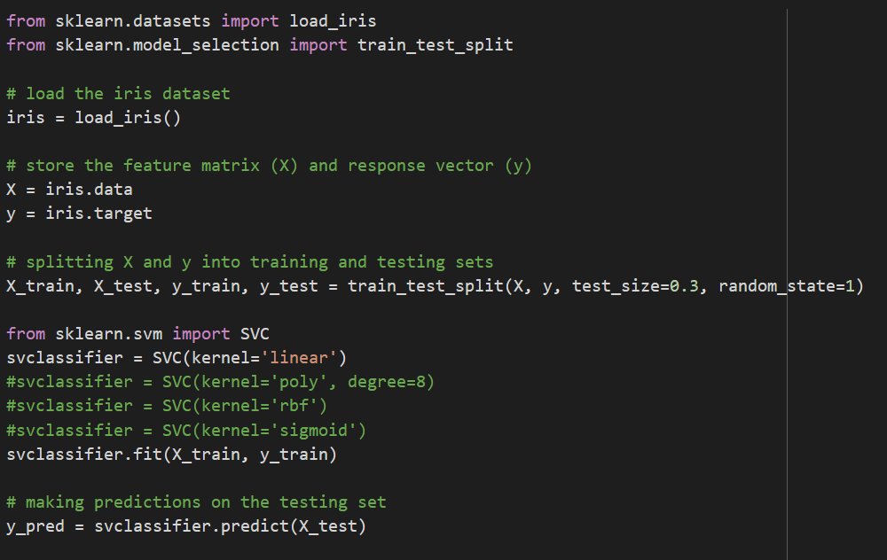
Support Vector Machine Classifier

Slide 36
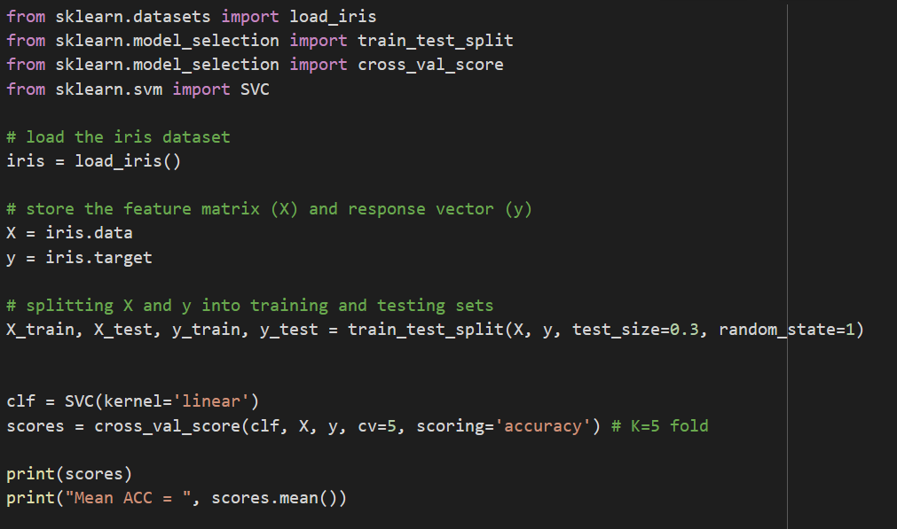
Support Vector Machine Classifier

Slide 37
Further Reading:
https://stackabuse.com/implementing-svm-and-kernel-svm-with-pythons-scikit-learn/
https://towardsdatascience.com/support-vector-machine-introduction-to-machine-learning-algorithms-934a444fca47
https://www.analyticsvidhya.com/blog/2021/10/support-vector-machinessvm-a-complete-guide-for-beginners/
Thank You.

